Slide 1

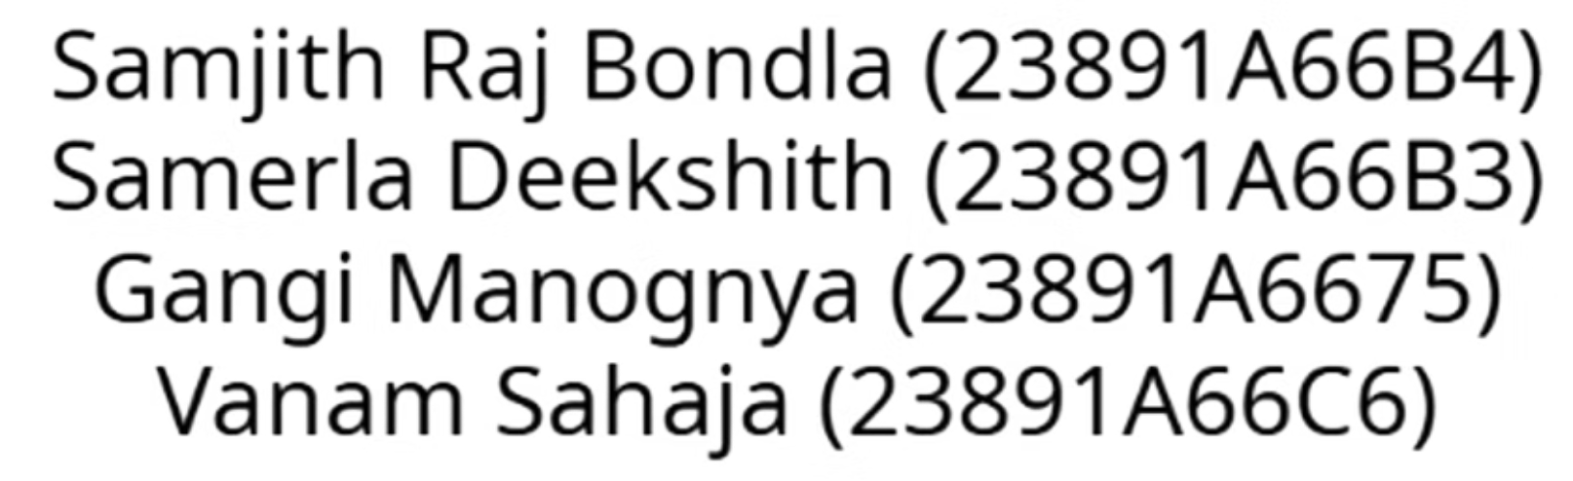
The Algorithm Playground: Bridging the Gap Between Theory and Practice
Design and Analysis of Algorithms (DAA) is a foundational yet frequently challenging subject for computer science students. The complexity of algorithms—such as Quick Sort, Dijkstra's, or A*—is often obscured by dense pseudocode or static diagrams. This theoretical density makes grasping the dynamic, step-by-step operation of these processes difficult.

Slide 2
The Problem: Abstraction Blocks Understanding
Static vs. Dynamic
Abstract Complexity
Lack of Interactivity
Reading pseudocode or looking at printed diagrams fails to convey the dynamic, time-based nature of algorithmic execution. Students struggle to visualize the continuous process of comparisons and swaps.
The tangible difference between time complexities like O(n²) and O(n log n) remains an abstract, mathematical challenge that is hard to connect to real-world performance.
Traditional learning materials do not allow users to manipulate the input data or control the execution flow, leading to passive learning rather than active engagement.
The Solution: Interactive Visualization
The Algorithm Playground addresses these issues by offering a hands-on, real-time environment. Users can select algorithms, control speed, manipulate data, and watch the process unfold, directly linking theoretical complexity with observed performance.

Slide 3



Core Project Objectives
The goal is to design, develop, and deploy a web-based educational tool centered around three core objectives that empower the learner.
Dynamic Visualization
Full User Control
Theory Bridge
Visually represent the step-by-step execution of diverse algorithms (Sorting, Searching, Pathfinding, etc.) using clear, intuitive graphical elements.
Provide extensive user interaction, including controls for execution speed, data generation, and scenario modification (e.g., drawing obstacles in pathfinding grids).
Display a dynamic panel that clearly explains the Time and Space Complexity for each selected algorithm, bridging the gap between practical visualization and theoretical DAA concepts.
This integrated approach ensures students not only see the algorithms work but also understand the underlying mathematical reasons for their efficiency.

Slide 4

Target Audience and Use Cases
The Algorithm Playground is designed to serve a broad educational community, ensuring maximum utility across different learning needs.
DAA Students: The primary audience. They use the tool to supplement lectures, solidify understanding of complex concepts, and prepare for exams by visualizing execution traces.
Educators & TAs: Use the platform as an invaluable visual aid during lectures, demonstrations, and tutorials to explain abstract concepts like recursion or graph traversal in a clear, compelling manner.
Self-Learners & Hobbyists: Individuals refreshing their foundational computer science knowledge or exploring new algorithmic techniques benefit from the clear, self-paced learning environment.
The goal is to make algorithmic analysis accessible, interactive, and memorable for everyone from a beginner to an advanced student.

Slide 5

User Stories: Designing for Experience
User stories guide the development process, ensuring the final product delivers specific, high-value interactive features that directly address common learning challenges.
Visual Comparison
As a student, I want to see a side-by-side comparison of Bubble Sort, Merge Sort, and Quick Sort so that I can visually understand why Quick Sort is faster.
Interactive Testing
As a user, I want to generate a new random array of bars so that I can test the sorting algorithms on different datasets instantly.
Scenario Setup
As a student, I want to draw "walls" on a grid so that I can see how pathfinding algorithms find a path around obstacles.
Theoretical Link
As a learner, I want to click on an algorithm's name and immediately see its Best, Average, and Worst-case time complexity.
Flow Control
As a user, I want to use a slider to control the visualization speed so that I can slow it down for fine details or speed it up for results.

Slide 6
Core Functional Requirements: Overview
The application must be structured logically, offering distinct modules for different algorithm types and featuring intuitive global controls.
FR1
Main UI
Tabbed Navigation
Clear tabs for "Sorting," "Searching," "Pathfinding," and "Dynamic Programming."
FR2
Controls
Global Controls
Include a "Start/Stop" button, "Reset," and a speed control slider.
FR3
Sorting
Algorithm Selection
Selection from Bubble, Selection, Insertion, Merge, Quick, and Heap Sort.
FR10
Complexity
Dynamic Panel
A dedicated panel must show Title, Time Complexity (Best, Avg, Worst), and Space Complexity.

Slide 7
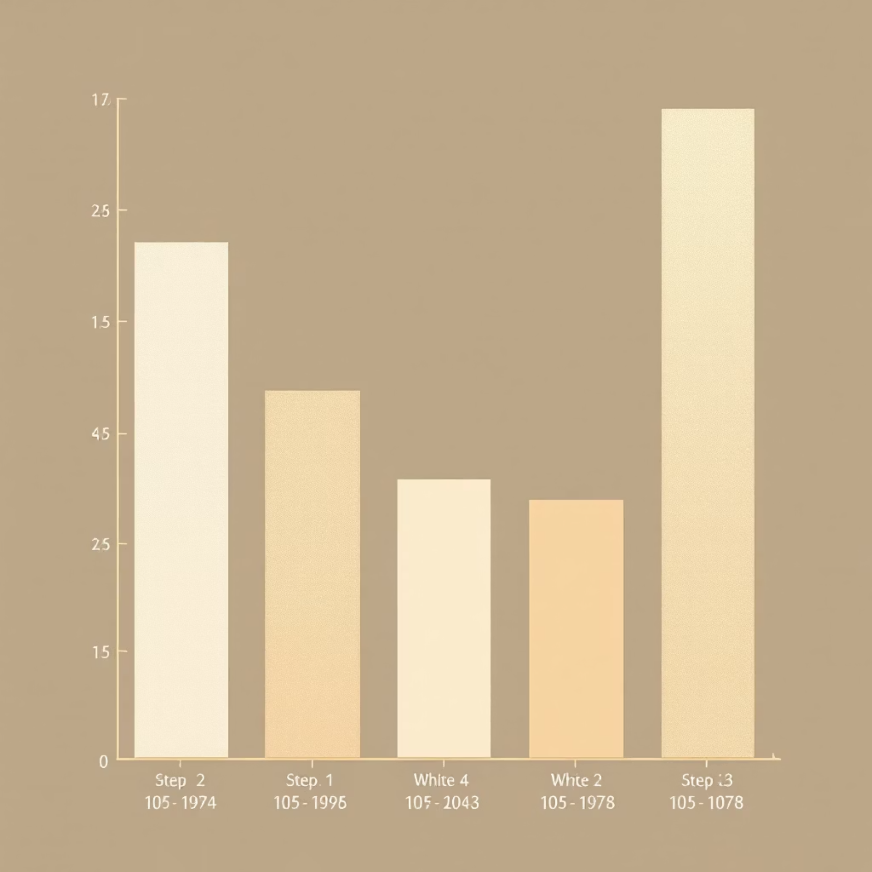





Deep Dive: Sorting Algorithm Visualizer
The sorting module is the centerpiece, designed to clearly differentiate the performance characteristics of various sorting methods through compelling visuals.
Sorting Functional Requirements
Selection
Allow users to choose from 6 key sorting algorithms: Bubble, Selection, Insertion, Merge, Quick, and Heap Sort.
Visualizer
An array of bars must dynamically represent the data, with height correlating to value.
Color Coding
Use color changes to clearly indicate which elements are being compared, swapped, or have reached their final, sorted position.
Data Control
A "New Array" button for generating random data arrays, allowing immediate re-testing under different conditions.
FR4: The visualizer must ensure bars are clearly distinguishable and movements are smooth, utilizing small asynchronous delays (NFR1).

Slide 8

Deep Dive: Pathfinding Visualizer
The pathfinding module focuses on graph algorithms, turning abstract graph theory concepts into an interactive, spatial puzzle.
Pathfinding Functional Requirements
Algorithm Set (FR6)
Selectable algorithms include Dijkstra's, A*, Breadth-First Search (BFS), and Depth-First Search (DFS).
Grid Display (FR7)
Display a 2D grid where colors denote visited nodes, permanent wall obstacles, and the final shortest path found.
Interactive Walls (FR8)
Users must be able to click-and-drag to "draw" or erase wall obstacles, customizing the search environment.
Draggable Nodes (FR9)
The start and end nodes must be draggable, enabling quick re-positioning to test new scenarios without a full reset.

Slide 9
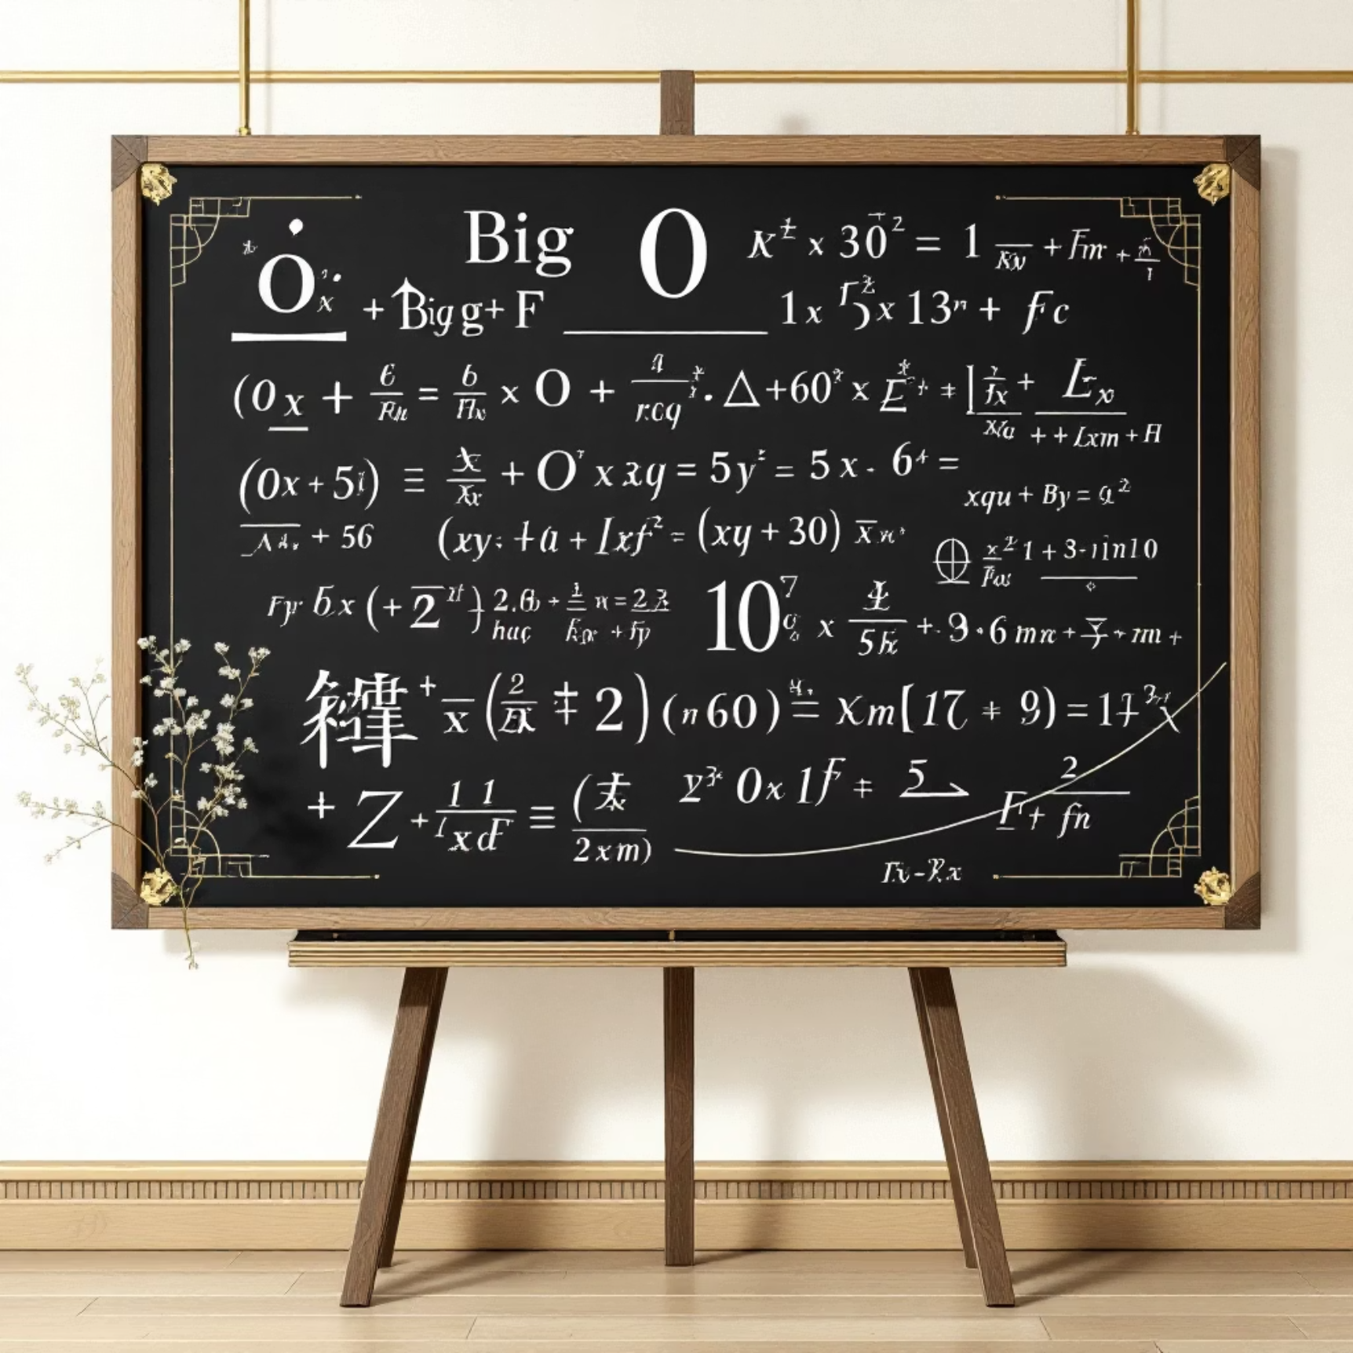



The Complexity Bridge: Theory Meets Practice
A crucial feature is the dynamic Complexity Panel (FR10/FR11), which instantly updates to provide theoretical context for the running visualization.
Dynamic Panel (FR10/FR11)
This dedicated panel must show the Title, Time Complexity (Best, Average, Worst), and Space Complexity. This panel automatically updates its content the moment a user selects a new algorithm.
Time Complexity
Includes notation for Best-case, Average-case, and Worst-case scenarios (e.g., O(1), O(log n), O(n²)).
Space Complexity
Outlines the auxiliary space required by the algorithm, explaining the memory trade-offs.
This feature reinforces the connection between the visible performance differences (e.g., Quick Sort finishing much faster than Bubble Sort) and the formal mathematical analysis provided by Big O notation.

Slide 10


Non-Functional Requirements: Ensuring Quality and Accessibility
To deliver a truly world-class educational tool, the implementation must adhere to strict quality and technical standards focusing on performance and user experience.
NFR1: Performance
NFR2: Usability
Visualizations must be smooth and non-blocking. Implementation requires careful use of asynchronous programming (async/await) and small delays to prevent UI freezing.
The interface must be intuitive, clean, and require no dedicated instruction manual to use effectively. Clarity is paramount.
NFR3: Responsiveness
NFR4: Portability
The layout must be fully functional and usable across all devices, including mobile phones, tablets, and desktop computers.
The application must be deployed as a single .html file, requiring no complex build process or external server dependencies. It must be 100% client-side.
The scope is intentionally constrained to a client-side application without user accounts, custom code submissions, or 3D visuals, ensuring focus on the core educational value: clear, fast, interactive 2D visualization.

